Slide 1

KNN

Slide 2
How KNN is Used In Regression
The K-Nearest Neighbors (KNN) algorithm, while often associated with classification, can also be effectively used for regression tasks.
Instead of predicting a category (as in classification), KNN regression predicts a continuous numerical value.
It does this by looking at the "K" closest data points in the training set to the new data point you want to predict.
Then, it calculates the average (or sometimes a weighted average) of the target values of those "K" nearest neighbors. This average becomes the prediction for the new data point.

Slide 3
Example
Imagine you have a dataset of house sizes (in square feet) and their corresponding prices. You want to predict the price of a new house based on its size.
Dataset:
House 1: 1000 sq ft, $200,000
House 2: 1200 sq ft, $240,000
House 3: 1500 sq ft, $300,000
House 4: 1800 sq ft, $360,000
House 5: 2000 sq ft, $400,000
Prediction:
Let's say you want to predict the price of a house that is 1600 sq ft.
You choose K = 3.
The algorithm calculates the distances between the new house (1600 sq ft) and all the houses in the dataset.
It finds the 3 closest houses (e.g., House 3, House 4, and House 5).
It then calculates the average price of those 3 houses: ($300,000 + $360,000 + $400,000) / 3 = $353,333.33.
Therefore, the predicted price of the 1600 sq ft house is approximately $353,333.33.

Slide 4
Optimal K Value

Slide 5
Cross-Validation
Elbow Method:
It involves splitting the dataset into multiple subsets
By evaluating the model's performance (e.g., accuracy, error rate) for various 'K' values across these folds, you can identify the 'K' that yields the best average performance.
It involves plotting the model's error rate (or accuracy) against different 'K' values.
The ‘elbow’ point where error starts to level off is considered optimal

Slide 6
Square Root Of N
A simple rule of thumb is to set 'K' to the square root of the number of data points in the training set.
While this can provide a reasonable starting point, it's generally not the most accurate method.
It is a quick method, but it does not account for the specific characteristics of the data.

Slide 7
Evaluation Metrics

Slide 8


ACCURACY
PRECISION
Measures the overall correctness of the model's predictions
Formula:
Indicates how often the model is correct when it predicts the positive class.
Formula:

Slide 9


RECALL
F1-SCORE
Shows how well the model captures all actual positive cases.
Formula:
Balances precision and recall, useful when both false positives and false negatives are important.
Formula:

Slide 10


Regression Metrics
Mean Squared Error (MSE)
Root Mean Squared Error (RMSE)
Calculates the average squared difference between predicted and actual values, penalizing larger errors.
Formula:
The square root of MSE, providing error in the same units as the target variable.
Formula:

Slide 11
Distance Metrics in K-Nearest Neighbors (KNN) – In Depth

Slide 12
Why Distance Matters in KNN?
KNN is a distance-based algorithm. The choice of distance metric affects:
Which neighbors are selected.
Model accuracy and performance.
Suitability to different data types and structures.

Slide 13
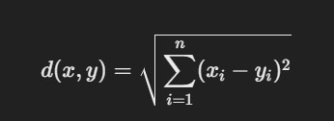
Euclidean Distance (L2 Norm)
Most commonly used metric in KNN. It measures the straight-line distance between two points in Euclidean space.

Slide 14

Manhattan Distance (L1 **Norm / Taxicab Distance)
Measures distance by only moving along axes (like driving in city blocks). Measures distance by only moving along axes (like driving in city blocks).

Slide 15
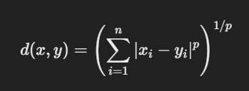
Minkowski Distance (Generalized Distance)
A generalization of Euclidean and Manhattan distances using a parameter 𝑝

Slide 16
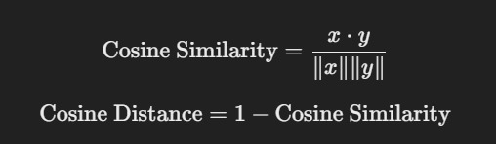
Cosine Similarity / Cosine Distance
Measures angle between vectors rather than magnitude.

Slide 17
KNN Application in Advanced Driver Assistance Systems (ADAS)
Advanced Driver Assistance Systems (ADAS) use machine learning techniques, including *K-Nearest Neighbors (KNN)
To enhance vehicle safety and automation.
KNN is particularly useful in ADAS for **real-time decision-making, classification tasks, and anomaly detection* due to its simplicity and ability to handle non-linear data.

Slide 18
Key ADAS Features Where KNN is Used
Traffic Sign Recognition (TSR)
Pedestrian Detection
Driver Drowsiness Detection
Collision Avoidance Systems

